Slide 1
Syllogism

Slide 2
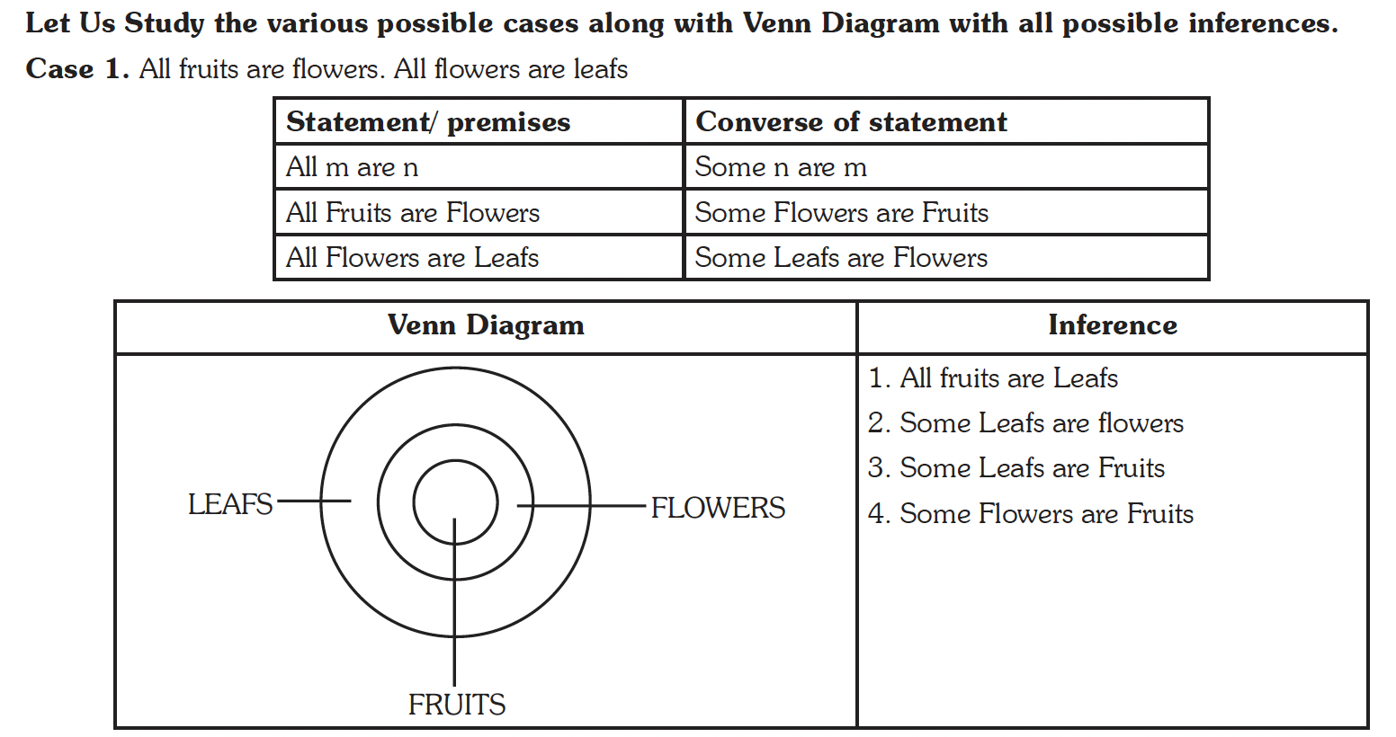

Slide 3
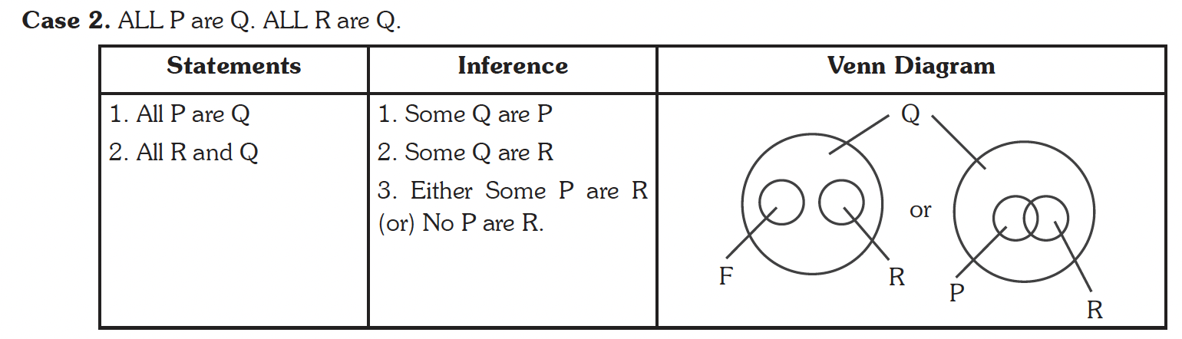

Slide 4
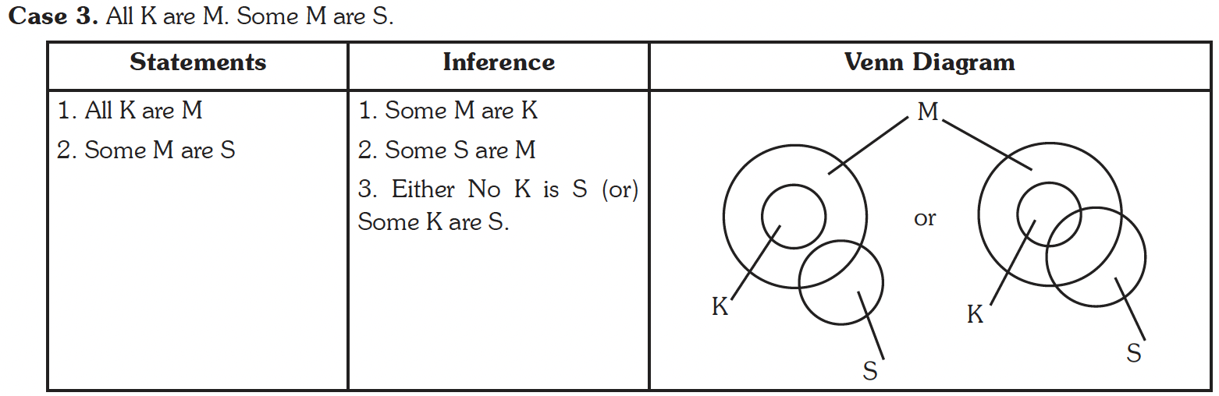

Slide 5
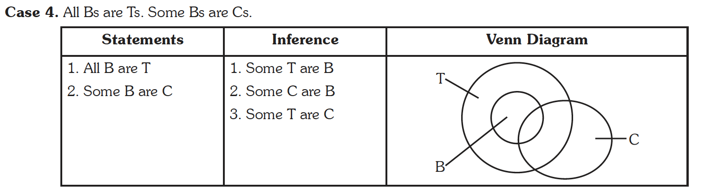

Slide 6
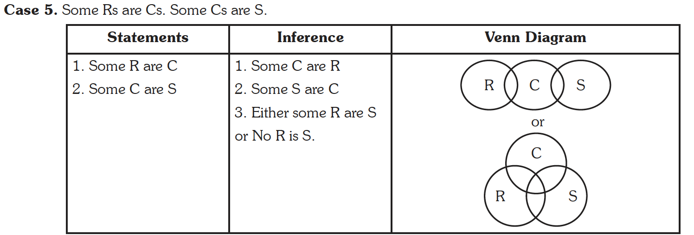

Slide 7
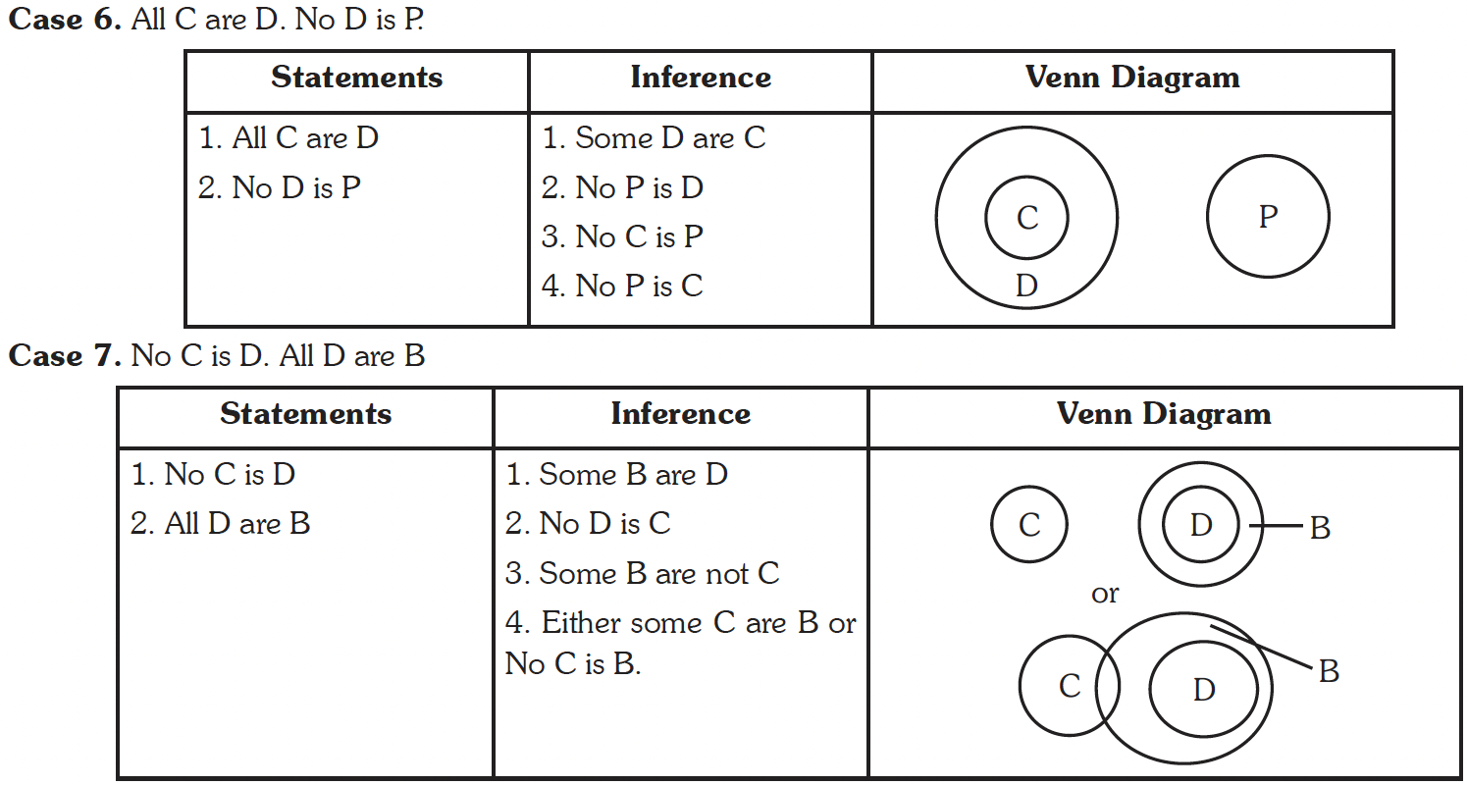

Slide 8
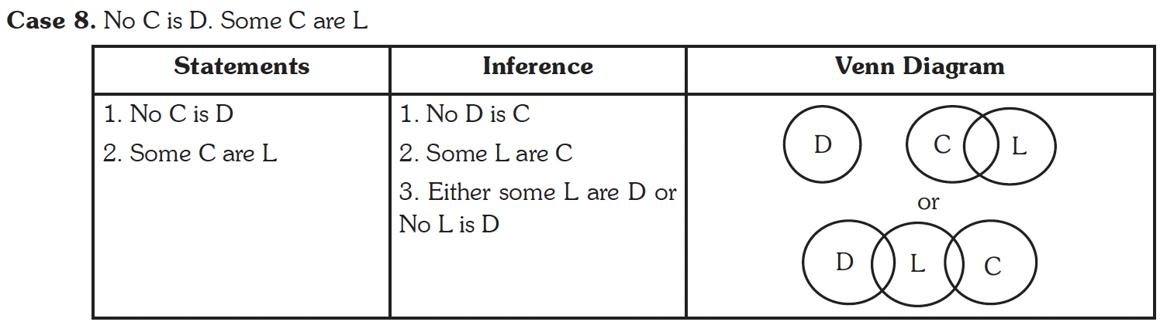

Slide 9
Practice
Questions

Slide 10
1. Statements:
All men are dogs.
All dogs are cats.
Conclusions.
I. All men are Cats.
II. All cats are men.

Slide 11
2. Statements:
No bat is ball.
No ball is wicket.
Conclusions:
I. No bat is wicket.
II. All wickets are bats.

Slide 12
3. Statements:
No women teacher can play.
Some women teachers are athletes.
Conclusions:
I. Male athletes can play.
II. Some athletes can play.

Slide 13
Possibility Based Questions

Slide 14
4. Statements:
All buildings are houses.
No house is an apartment.
All apartments are flats.

Slide 15
5. Statements:
Some oceans are seas.
All oceans are rivers.
No river is a canal.

Slide 16
6. Statements:
No day is night.
All nights are noon.
No noon is an evening

